Slide 1

Internet Programming I
Chapter 4
JavaScript: Array in Java Script
Group: 3
3rd Year Sec B Students,
Dept. of Software Eng.
Jan 2022, AASTU

Slide 2

Objectives
After success completion of the session you will be able to:
Understand declaration and initialization of array in JavaScript
Understand the how the array methods work
Manipulate arrays by using JavaScript built in methods

Slide 3
Outline
Array
Declaration and Initialization of arrays
Array Element Manipulation
Array Methods in JavaScript

Slide 4
1. What are arrays in JS?
An array is a collection of similar data elements stored at contiguous memory locations
But in JavaScript, an array is an ordered list of values either similar or mixed in data type.
Arrays are list-like objects whose prototype has methods to perform traversal and mutation operations.
In java script arrays are considered to be type of objects.
The difference between arrays and objects is:
Arrays: use numbered indexes.
Objects: use named indexes.

Slide 5
2. Declaration and initialization
We have two methods to declare an array in JavaScript
Using array literals
let/const/var arrayName = [list1,list2…..listN];
By using array constructor
let/const/var arrayName = new Array(list1,list2..listN);
NOTE: We can use both declaration methods but for simplicity we use the first one mostly.

Slide 6
3. Manipulation of array elements
Accessing and assigning value
In similar way with other programming langusages we use bracket notation to assign and access array elements in JavaScript.
Example
const cars = [ "Saab", "Volvo", "BMW“ ]; //assigning let car = cars[0]; //accessing one element
cars[1] = “Toyota”; // assigning value
We can also use built in functions to do the same thing
push() : for appending element at the end
pop() : for removing and returning value at the top

Slide 7
Array element manipulation example
const numbers = []; // array declaration with literals
const peoples = new Array("John","jack","Brian"); // array declaration with array constructor
for(let i=0;i<4;i++){
numbers[i] = (i+2);
}
document.write(numbers + "<br>"); // will write the whole array into the document as
//list of numbers separated by commalike 2,3,4,5
document.write(numbers[0] + "<br>"); // accessing array element
numbers[0] = 10; // assigning value to an element using index notation
document.write(numbers[0] + "<br>"); //prints 10
numbers.push(25); //add 25 at the end of the array
document.write(numbers + "<br>"); //prints 10,3,4,5,25
document.write(numbers.pop()); // removes the last element return it

Slide 8
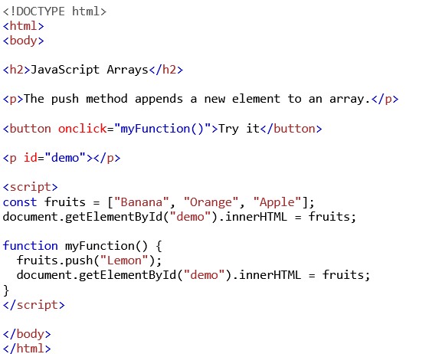
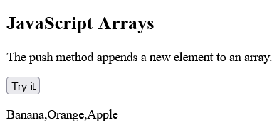
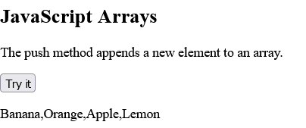
Example cont’d
FIRST OUTPUT
AFTER PRESSING TRY IT BUTTON

Slide 9
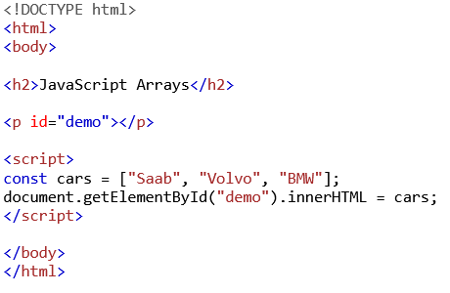
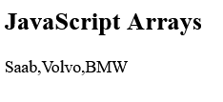
Fig: Accessing entire array element
OUTPUT

Slide 10
Traversing over arrays
We can use looping statements to iterate over arrays.
Indexed for loop
Example :
const peoples = new Array("John","Alex","Brian","Abebe","Bekele","Nati","Nardos");
for(let i=0;i<10;i++){
console.log(peoples[i]);
}
2. for in loop : are used to loop through the properties of an Object, meaning gives us the keys to iterate over the object.
Syntax
for(let itrVar in ArrayName){
// any operation
} itrVar will contain the key for the array

Slide 11
Traversing over arrays cont’d
Let’s use the above exapmle
for(let key in peoples){
console.log(peoples[key]); // prints elements of peoples to the console
}
3. For of loop : used to traverse over the values of the object. Unlike the for in loop which iterates over the keys of the object, for of loop accesses the values of the objects.
Syntax
for(let itrVar of ArrayName){
// any operation
} itrVar will contain the values in the array

Slide 12
4. Array Methods
JavaScript has many built in methods to manipulate arrays.
Methods for array element
addition and removal
operations
push() : append element at the end
pop(): removes and returns value at
the end
splice(): to add and/or remove elements
shift() : removes the first element
unshift() : add element at the begining
Method | syntax | parameter | Return value
push() | array.push(value) | Value to be inserted | New length of the array
pop() | array.pop() | No parameter | Value of the popped element
shift() | array.shift() | No parameter | Remove and return the first element
unshift() | array.unshift(v1,v2,..vn) | Infinite number of values to be inserted,at least one | New array length
splice() | array.splice(start index, how many, item1,item2…itemN) | - Index from which removal starts => required -How many => number of items to be removed(optional) -items to be added in place of the deleted items => optional | Array containing removed items

Slide 13
5. Array Methods cont’d
Methods to create array from an array
copyWithIn()
slice()
Array.from()
concat()
Example
const peoples =
new Array("John",
"Alex",
"Brian",
"Abebe",
"Bekele",
"Nati","Nardos");
Method | syntax | parameter | Return value
copyWithin() | array.copyWithin(from index, to index) | Start index and ending index | Array containing the elements with in the specified index interval
slice() | array.slice(from index, to index) | Start index and ending index(not included) | Array containing the elements with in the specified index interval
Array.from() | Array.from(string) | String from which we want to create an array | Array of the string inerted
concat() | rootArray.concat(arr1,arr2,..arrN) | Arrays to be concatenated with the root array | New array

Slide 14
peoples.push("Gigi"); //add Gigi at the end
peoples.pop(); // removes and return Gigi
peoples.shift(); // removes and return first element => John
peoples.unshift("Bethel"); // insert Betel at the beginning
document.write("<br>" + peoples + "<br>"); // prints Bethel,Alex,Brian,Abebe,Bekele,Nati,Nardos
document.write(peoples.slice(0,2) + "<br>"); // prints Bethel,Alex
peoples.concat("Yonnas","Honok"); // concatinates all the arrays into one array and return it

Slide 15
6. cont’d
Sorting functions
sort()
reverse()
Method | syntax | parameter | Return value
sort() | array.sort() | Optional compare function | Returns the array in sorted form
reverse() | array.reverse() | No parameter | Array in reversed order to the original array

Slide 16
7. cont’d
Methods used to implement a function on each element
every() :
filter()
foEach()
map()
Method | syntax | parameters | Return type
every() | array.every(functionName) | Function for test | True if all items pass the test,else false
filter() | array.filter(functionName) | Function for test | Array containing the elements which passed the test
forEach() | array.forEach(functionName) | Function to act on each elements | no
map() | array.map(functionName) | Function that performs the manipulation on items | Return new array
some() | array.some(function) | Function for test | true,false(boolean) True if at least one element satisfies the test condition
reduce() | array.reduce(function) | Function for test | One reduced value for elements

Slide 17
Example
var total = 0;
function MoreThan6(item){
return item > 6;
}
function double(value){
return value*2;
}
function sum(value){
total += value;
}
function startWith(item){
return item.toLowerCase().startsWith("a");
}

Slide 18
Cont’d
const result = numbers.filter(MoreThan6);
document.write(result + "<br>"); // will print 10,7,8,9,10,11
document.write(numbers.map(double) + "<br>"); // 20,6,8,10,12,14,16,18,20,22
document.write(numbers.every(MoreThan6) +"<br>"); // return false
numbers.forEach(sum);
document.write(total + "<br>"); // print 73
document.write(peoples.filter(startWith)); // Alex,Abebe

Slide 19
Array methods cont’d
Method | syntax | parameters | Return type
find() Finds an element that satisfies the test condition | array.find(function) | Function containing test condition | Returns first element that passes the test in the function, else return undefined
includes() Checks the existence of an element | array.includes(value) | Value to be searched | Boolean True, if exists false, if not exist
indexOf() | array.indexOf(value) | Value to be searched | if found return Index of value else -1
lastIndexOf() | array.lastIndexOf(value) | Value to be searched | Starts search from the last element if found return Index of value else -1
findIndex() | array.findIndex(function) | Function for test condition | Return the index of the element for the value that passes the test,else return -1
Methods for searching
find()
indexOf()
lastIndexOf()
findIndex()

Slide 20
Example
const word = peoples.find((value)=>{return value.startsWith("B")}); // returns first match element starts with 'B'
console.log(word); // print ot console of the broser
const index = peoples.findIndex((value)=>{return value.endsWith("x")}); // returs index of the element that matches the condition,1
console.log(peoples[index]); // prints value at the index returned by the above method => Alex
const index2 = peoples.indexOf("Nati"); // starts search from the begining and returns index of 'Nati' if exist else -1 (returns 2)
const index3 = peoples.lastIndexOf("Nati"); // starts search from the end and returns index of 'Nati' if exist else -1 (returns 6)
const isFound = peoples.includes("Peter"); // returns true if exist else false ==> (retrurns false)

Slide 21
Array prototype
In javascript the Array object has a property called prototype that is used to allow to add new methods and properties to the Array() object. syntax
Array().prototype.Name = value;
new property or method name function definition that performs the new functionality
For example if we want to expand the functionality of the object by adding a method that converts all the elements of an array of strings to uppercase or lowercase we can add our custom method in to the object.

Slide 22
Example
const peoples = new Array("John","Alex","Nati","Brian","Abebe","Bekele","Nati","Nardos"); // array declaration with array constructor
Array.prototype.upperCase = function() {
for (let i = 0; i < this.length; i++) {
this[i] = this[i].toUpperCase(); // `this` refers the object later will be substituted by the array
}
}; // custom method to convert all the elements of an array of string to upper case
peoples.upperCase(); // upperCase() method called
console.log(peoples); // prints this to console ['JOHN', 'ALEX', 'NATI', 'BRIAN', 'ABEBE', 'BEKELE', 'NATI', 'NARDOS']

Slide 23
Demosnatration Example code
<div class="main">
<div class="input-con">
<label for="sub1">subject 1</label>
<input type="text" name="mark1" id="sub1">
</div>
<div class="input-con">
<label for="sub2">subject 2</label>
<input type="text" name="mark2" id="sub2">
</div>
<div class="input-con">
<label for="sub3">subject 3</label>
<input type="text" name="mark3" id="sub3">
</div>
<div class="input-con">
<label for="sub4">subject 4</label>
<input type="text" name="mark4" id="sub4">
</div>
<div class="input-con">
<label for="sub5">subject 5</label>
<input type="text" name="mark5" id="sub5">
</div>
<div class="input-con">
<label for="sub6">subject 6</label>
<input type="text" name="mark6" id="sub6">
</div>

Slide 24
<div class="btn">
<button type="button" id = "btn-1">Save</button>
</div>
<div class="btn">
<button type="button" id = "btn-2" title = "reduce() to sum value">Total</button>
</div>
<div class="btn">
<button type="button" id = "btn-3">Average</button>
</div>
<div class="btn">
<button type="button" id = "btn-4" title="subarray of marks > 90 map()/filter()">Marks more than 90</button>
</div>
<div class="btn">
<button type="button" id = "btn-5" title="find if 100? find()/indexOf()">is there 100?</button>
</div>
<div class="btn">
<button type="button" id = "btn-6" title="sorting increasing order sort()">increasing order</button>
</div>

Slide 25
Demosnatration Example code
<div class="btn">
<button type="button" id = "btn-7" title="reverseSort() custom method">Decreasing order</button>
</div>
<textarea name="result" id="result" cols="30" rows="10"></textarea>
</div>
<script>
Array.prototype.reverseSort = (marks)=>{marks.sort(function(a,b){return b-a;}); return marks;} // customized method to sort in descending order
var inputs = document.querySelectorAll("input");
console.log(inputs);
const save = document.getElementById("btn-1");
const total = document.getElementById("btn-2");
const average = document.getElementById("btn-3");
const More90 = document.getElementById("btn-4");
const find100 = document.getElementById("btn-5");
const sort = document.getElementById("btn-6");
const reverse = document.getElementById("btn-7");
const write = document.getElementById("result");

Slide 26
Demosnatration Example code
var marks = [];
console.log(marks);
function store(){
marks = [];
for(let mark of inputs){
marks.push(Number(mark.value));
}
console.log(marks);
}
function findValue(value){
return value == 100;
}
function moreThan90(value){
return value > 90;
}
function sum(sum,value){
return (sum) + (value);
}
save.setAttribute("onclick","store()");

Slide 27
Demosnatration Example code
total.onclick = ()=>{
write.innerText = "Total mark = " + marks.reduce(sum,0);
}
average.onclick = ()=>{
write.innerText = "Average mark = " + (marks.reduce(sum,0))/6;
}
More90.onclick = ()=>{
write.innerText = "marks more than 90 = " + marks.filter(moreThan90);
}
find100.onclick = ()=>{
write.innerText = "is there any mark of 100?" + `at index ${marks.findIndex(findValue)}`; // marks
}
sort.addEventListener("click",()=>{
marks.sort((a,b)=>{return a-b});
write.innerText = "sorted in increasing order: " + marks;
});
reverse.addEventListener("click",()=>{
marks.reverseSort(marks);
write.innerText = "sorted in decreasing order: " + marks;
})
</script>

Slide 28
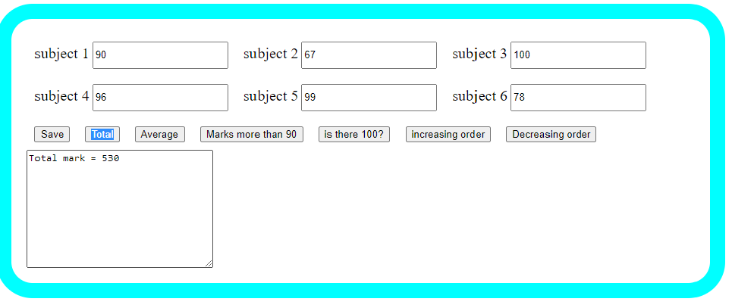
Demosnatration Example Output

Slide 29
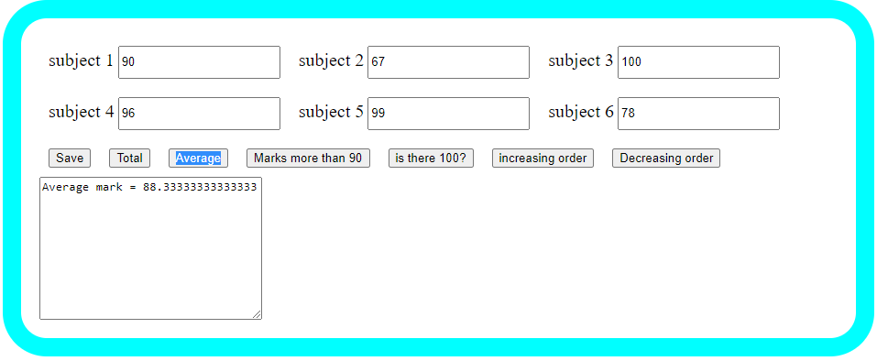
Demosnatration Example Output

Slide 30
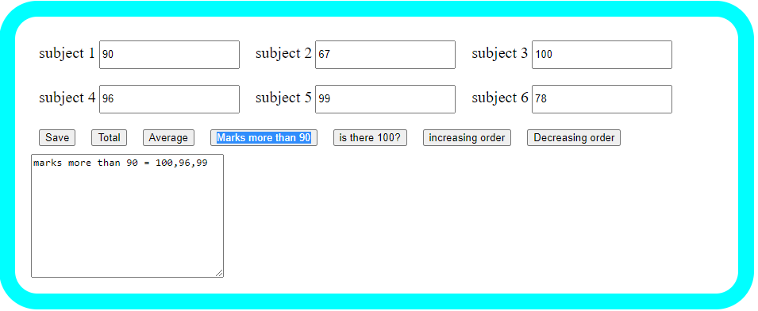
Demosnatration Example Output

Slide 31
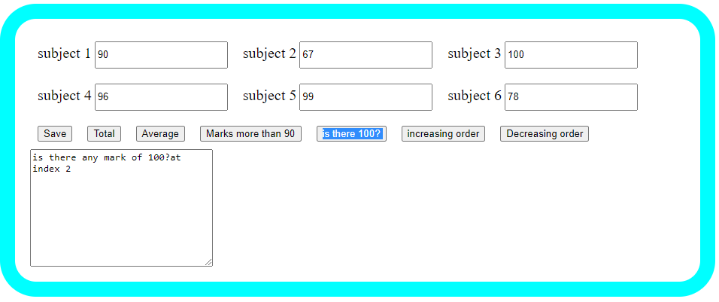
Demosnatration Example Output

Slide 32
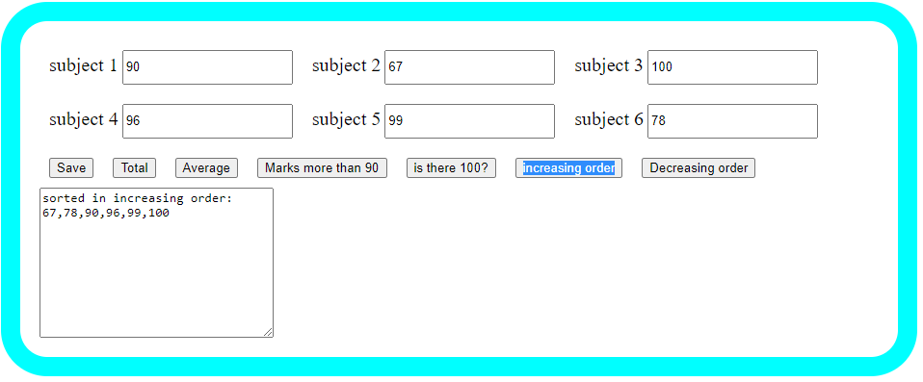
Demosnatration Example Output

Slide 33
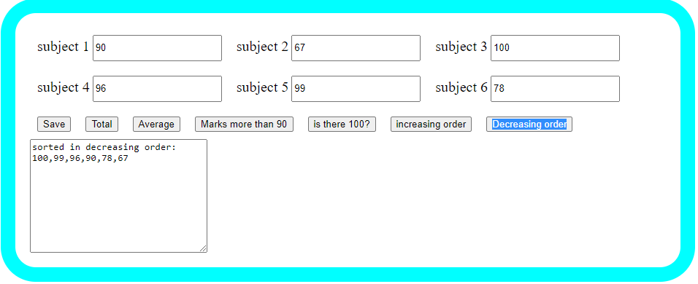
Demosnatration Example Output

Slide 34
Reading Resources/Materials
Chapter X (if you used text book)
Jon Duckett; HTML and CSS Design and Build Websites, 2011 John Wiley & Sons, Inc., Indianapolis, Indiana
Links
Paul Deitel,

Slide 35

Thank You
For Your Attention!!

